Slide 1
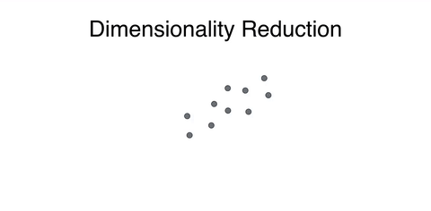
Principal Component Analysis (PCA)

Slide 2
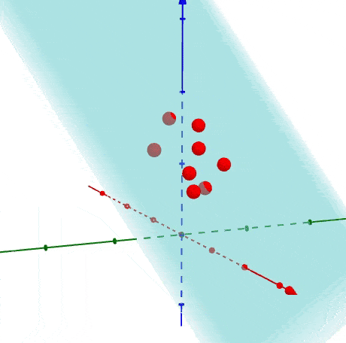
Why Do We Need PCA?
High-dimensional data can be noisy and computationally expensive.
PCA helps reduce dimensionality while preserving key information.
Example: Genomic data with thousands of features can be reduced to a few meaningful dimensions.

Slide 3
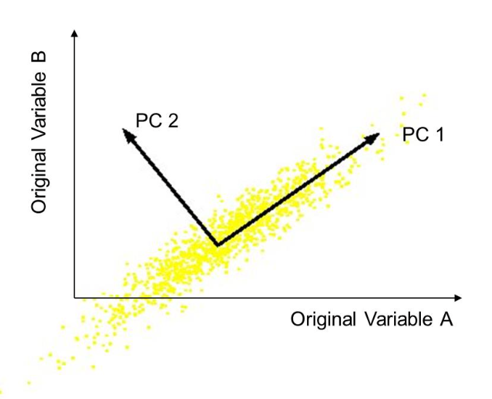
Overview of PCA Computation
PCA finds new axes that maximize variance in data.
It transforms correlated variables into uncorrelated principal components.
New axes:
Orthogonal directions of greatest variance in data
Projections along PC1 discriminate data the most along any one axis

Slide 4
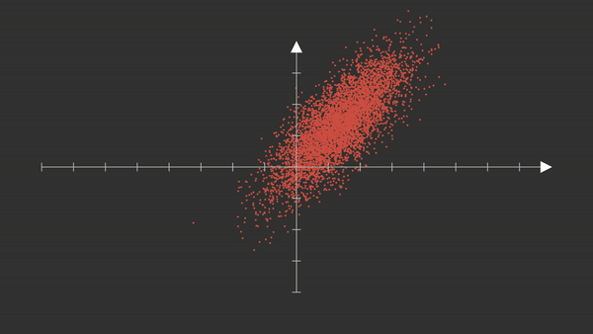

Slide 5
Step 1: Mean-Center the Data
Compute the mean of each feature.
Subtract the mean from the original data to center it around zero.
This ensures that PCA captures variance rather than absolute values.

Slide 6
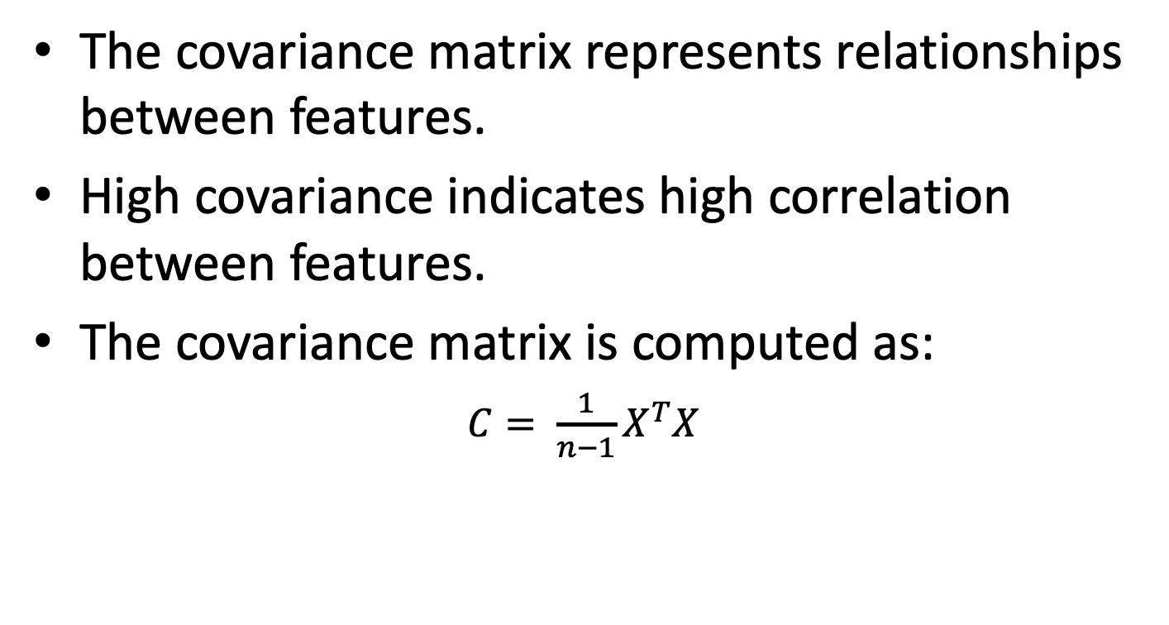
Step 2: Compute Covariance Matrix
The covariance matrix represents relationships between features.
High covariance indicates high correlation between features.
The covariance matrix is computed as:
$C= \frac{1}{n−1}X^{T}X$

Slide 7
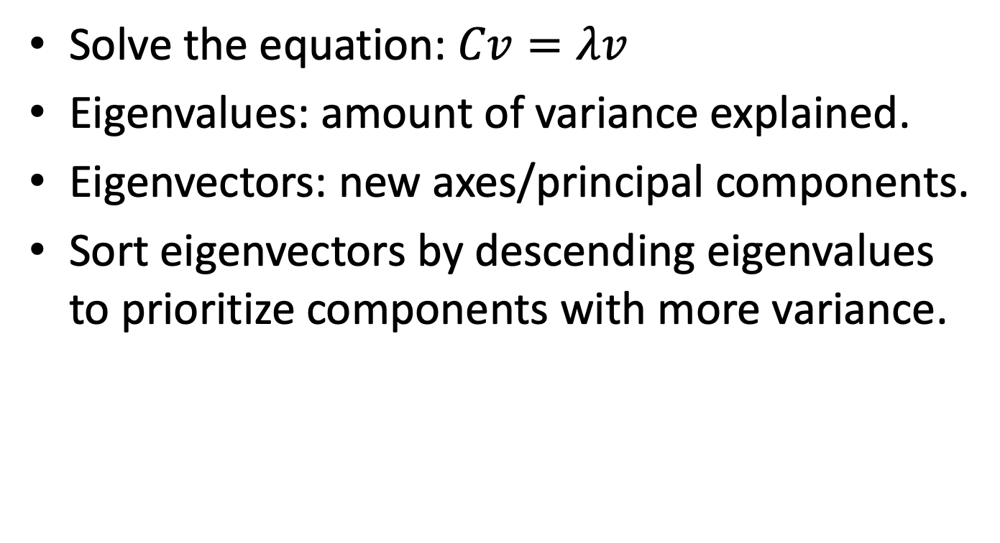
Step 3: Compute Eigenvalues & Eigenvectors
Solve the equation: $Cv=λv$
Eigenvalues: amount of variance explained.
Eigenvectors: new axes/principal components.
Sort eigenvectors by descending eigenvalues to prioritize components with more variance.

Slide 8
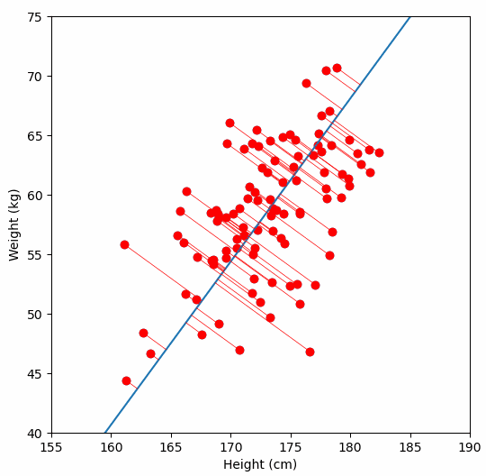
Step 4: Project Data onto Principal Components
Multiply the original data by the top-k eigenvectors to transform it.
The new coordinates are called principal components.
Retaining top-k components reduces dimensionality while preserving key patterns.

Slide 9
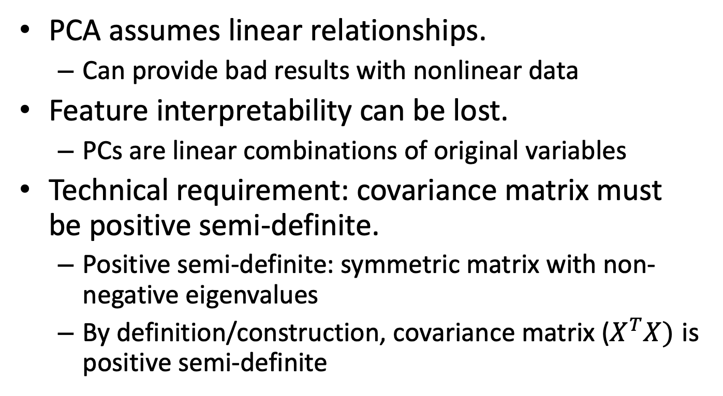
Limitations of PCA
PCA assumes linear relationships.
Can provide bad results with nonlinear data
Feature interpretability can be lost.
PCs are linear combinations of original variables
Technical requirement: covariance matrix must be positive semi-definite.
Positive semi-definite: symmetric matrix with non-negative eigenvalues
By definition/construction, covariance matrix ($X^{T}X)$ is positive semi-definite

Slide 10
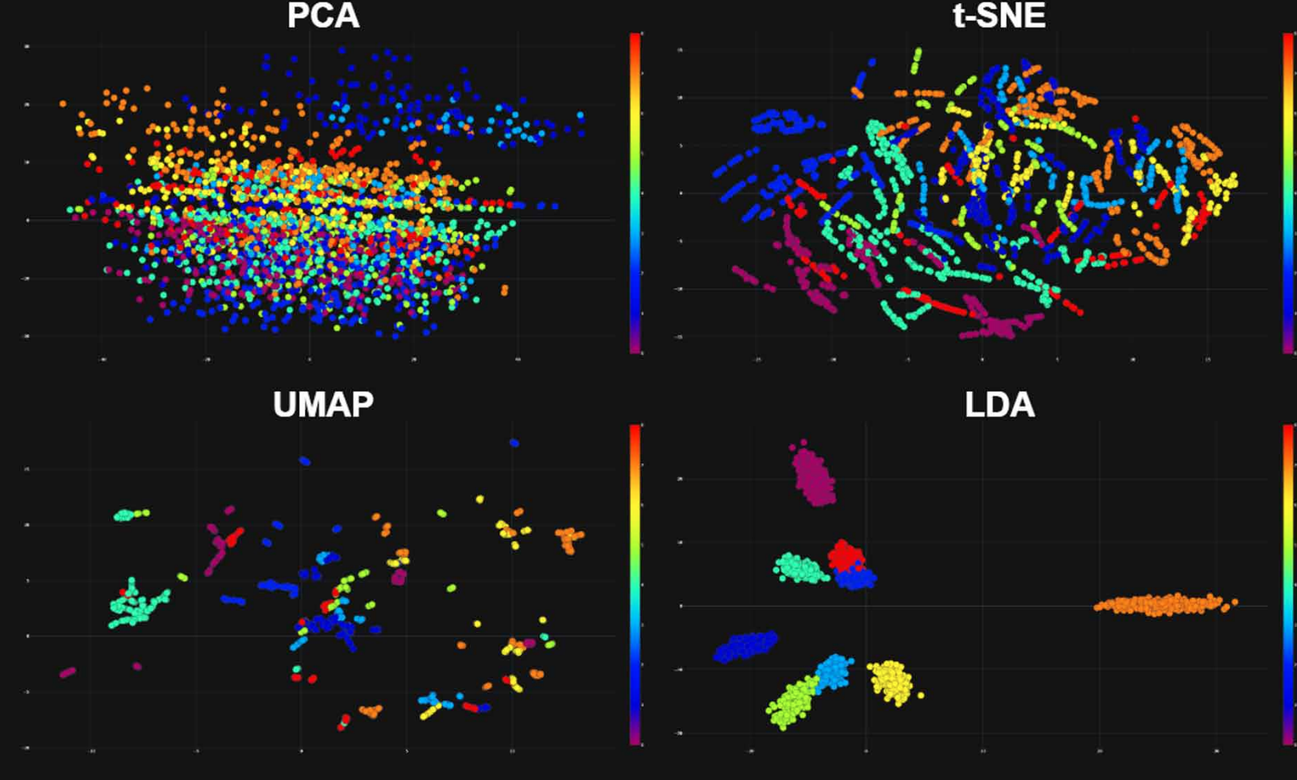
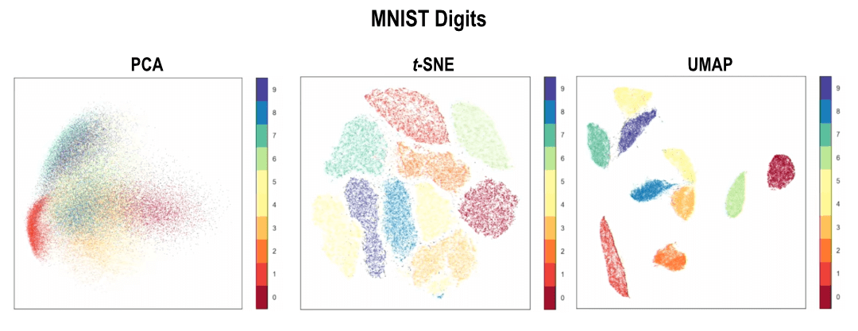
Future Considerations
Comparison with different dimensionality reduction techniques.
PCA vs. t-SNE vs. UMAP etc

Slide 11
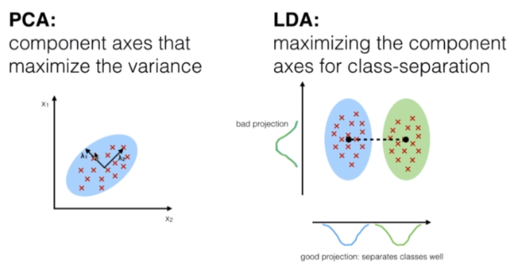
Future Considerations
Combine with clustering algorithms for unsupervised learning pipelines.
ie PCA + Kmeans
Compare to LDA (supervised learning)

